Slide 1
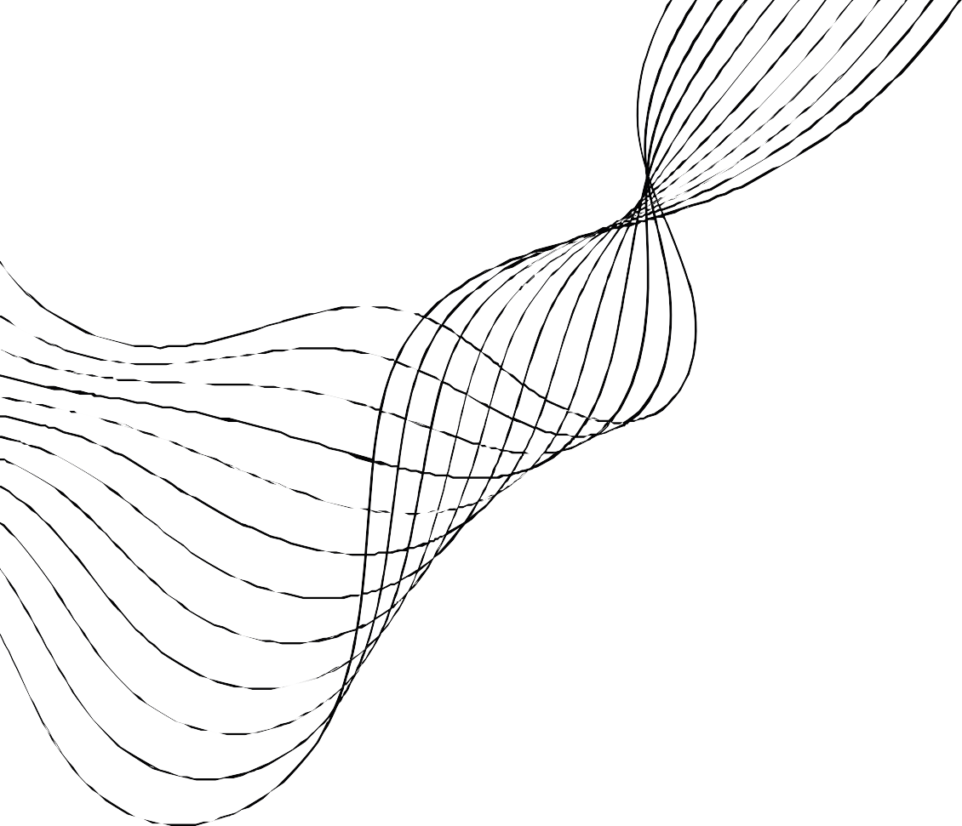
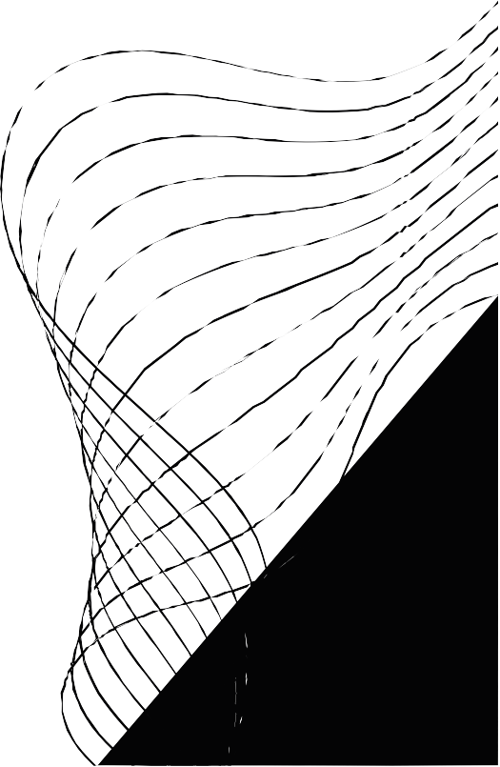
2D SLAM-based Childcare Robot
WWW.NANNYBOT.COM.AU

Slide 2

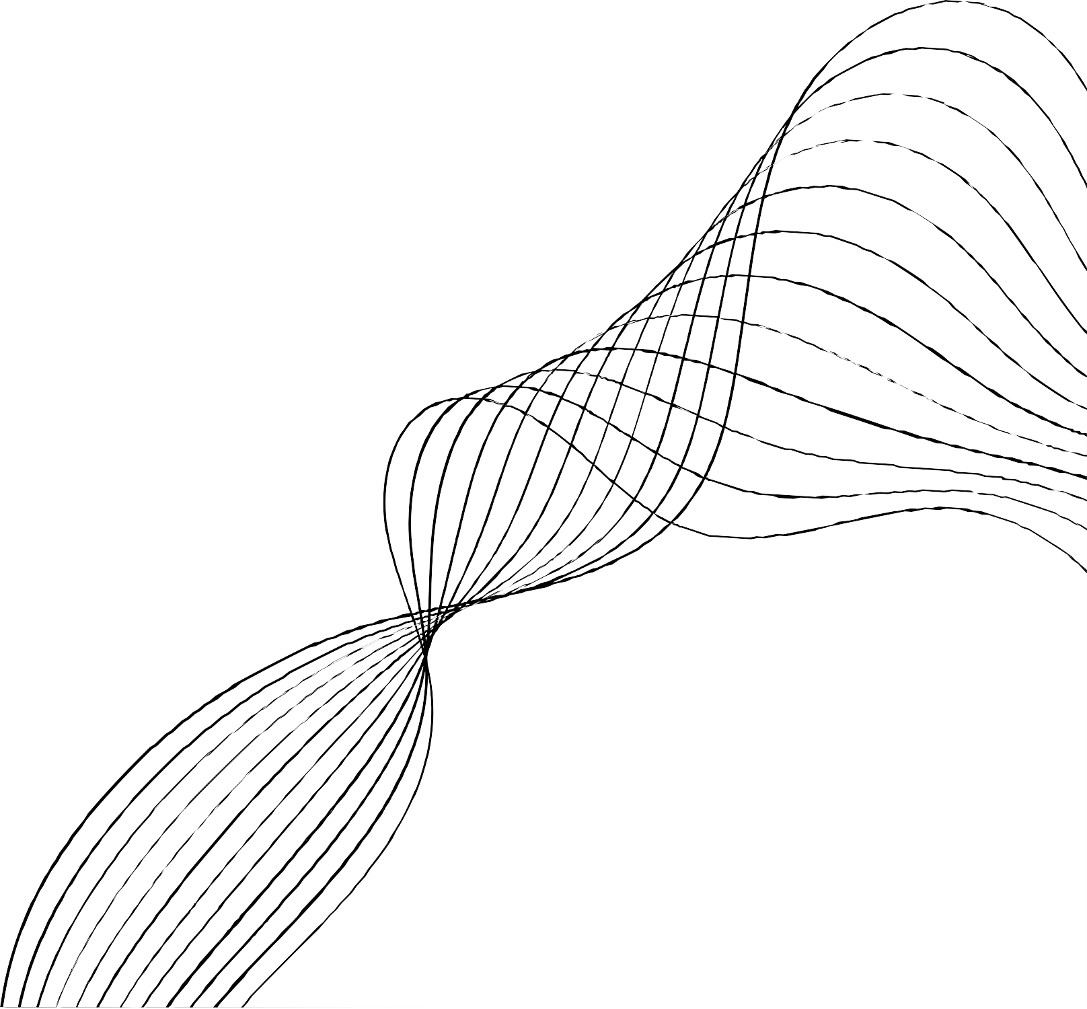
OUR TEAM
Mary
Yazbek
Director of Operations
Meghna Meghna
Project Manager
John
Machado
Project Manager
Patrick Weinstein
Project Manager

Slide 3





Introduction
Falls are a leading cause of injury among children, prompting thousands of emergency visits daily in the U.S. due to accidents involving stairs and windows.
This issue highlights the need for enhanced supervision in environments like kindergartens, where constant vigilance is challenging.
Our project proposes using 2D SLAM robots equipped with LiDAR sensors for real-time navigation and monitoring within indoor settings such as schools and childcare centers.

Slide 4


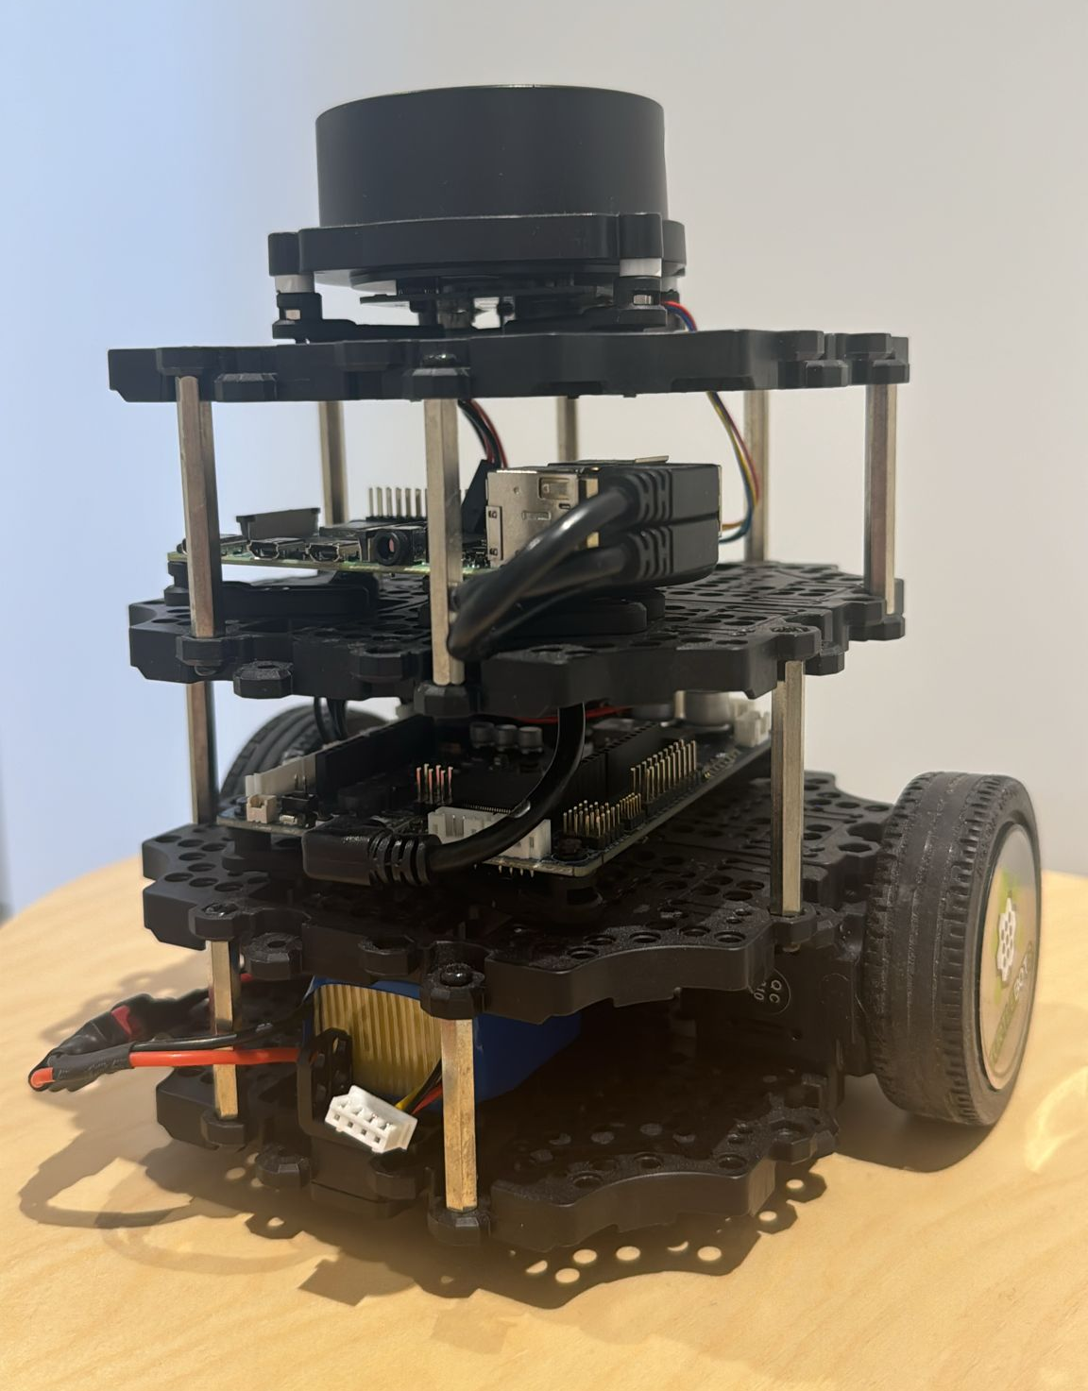
Project Objectives
Develop an Autonomous Navigation System
Integrate Real-Time Obstacle Detection and Avoidance
Optimize Hardware and Software Performance
Test and Validate System in Real-World Scenario

Slide 5
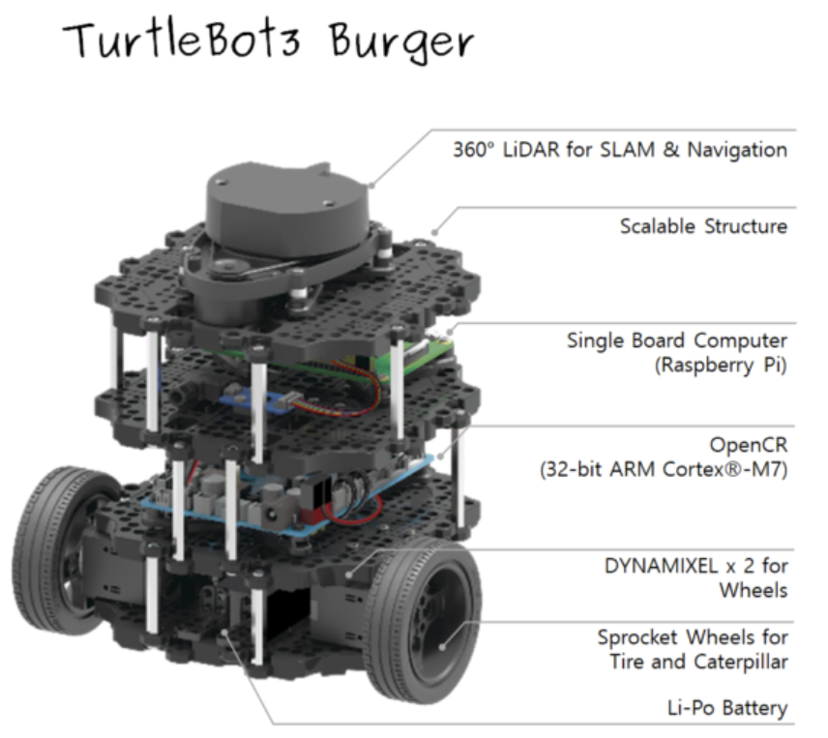
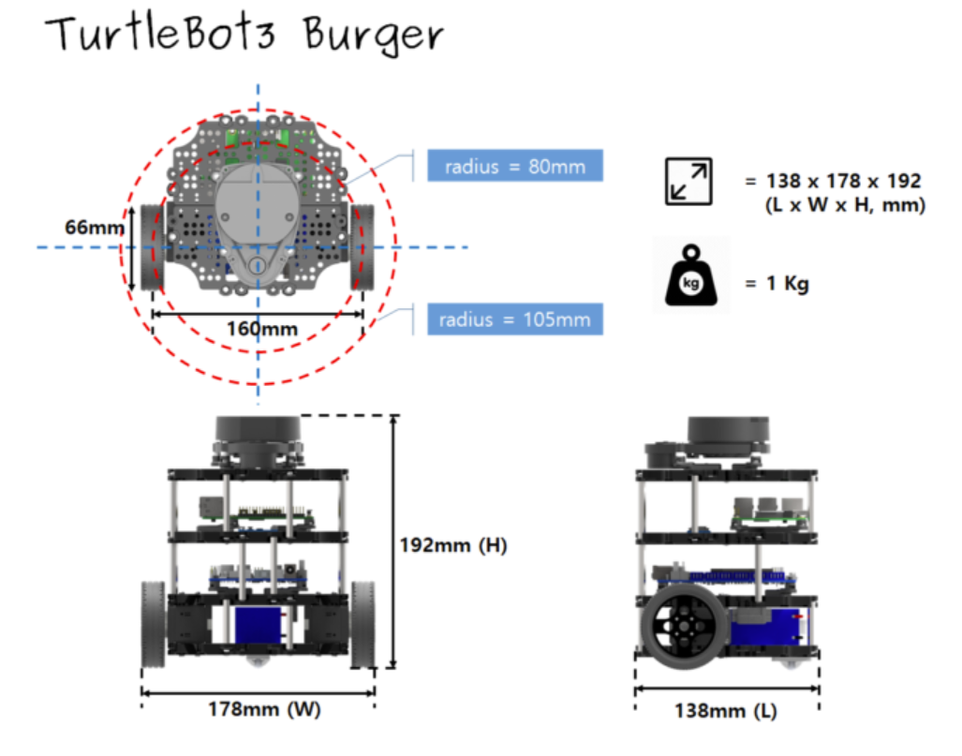
Hardware
360˚ LDS-02 LiDAR
Raspberry Pi (Single Board Computer)
OpenCR
IMU Unit
12V Li-Po battery
Remote PC (Windows)

Slide 6
Software
Ubuntu 20.04 is used as the operating system on the Oracle Virtual Machine.
ROS Noetic, running on Ubuntu, includes packages specifically for the TurtleBot3 Burger.
Gazebo is used to run simulation experiments.
Rviz, a 3D visualization tool, is used in both simulated and actual experiments.
The combination of ROS and Gazebo speeds up the move from simulation to real deployment, making sure that what’s developed in Gazebo can be directly applied to the actual TurtleBot3 Burger robots.

Slide 7
Algorithms
SLAM
The ROS Gmapping package is utilized for SLAM to generate a map of the surroundings.
Localization
Utilization of AMCL: Adaptive Monte Carlo Localization (AMCL) is utilized to determine the robot's precise location, i.e. position and orientation.
Particle Filter Application: A particle filter is deployed within a predefined map to enhance the robot's navigation accuracy.
Navigation
Global Planner: Utilizes the NavfnROS planner implementing Dijkstra’s algorithm to create a route from the robot's current location to its destination across the entire known map.
Local Planner: Employs the Dynamic Window Approach Planner (DWA) which dynamically updates the robot's path in real-time based on the global plan and changes in the local environment.

Slide 8
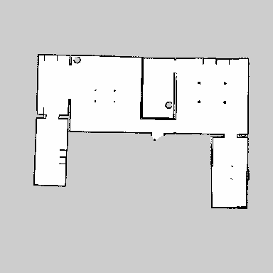
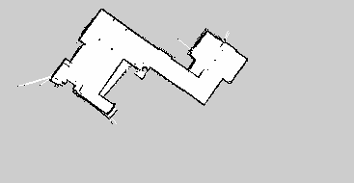
Results
Simulated Experiments:
Successfully created 2D maps in Gazebo simulations using Gmapping at an optimal speed of 0.1 m/s.
Efficient navigation with global and local cost maps for obstacle avoidance.
Real-World Experiments:
In an apartment, the robot mapped with a 5.45% error rate when comparing 2D map data with real-world measurements.
Autonomous navigation was successful with accurate localization and real-time obstacle avoidance.

Slide 9
Results
Object | Actual Measurement | 2D Map Measurement
Table | 0.80 m | 0.73 m
Couch | 2.43 m | 2.23 m
Width of Thin Corridor | 1.00 m | 0.94 m

Slide 10
Future Improvements
Advanced Sensors: Consider 3D SLAM and depth cameras for improved mapping.
AI & Machine Learning: Use machine learning for smarter path planning and real-time adaptation.
Human Interaction: Add voice/gesture recognition for better interaction.
Energy Efficiency: Improve battery life for longer operation.

Slide 11
Ethical Considerations
Privacy Protection:
The robot uses LiDAR sensors, not cameras, to avoid capturing personal images. Data is securely encrypted to protect privacy.
Informed Consent: Daycare staff and parents were fully informed about the robot’s functions and data use, with their consent obtained.
Staff and Child Well-being: The robot assists staff, reducing their workload while improving child safety, without replacing human caregivers.

Slide 12

Challenges and Solutions
Challenge 1: Inaccurate Mapping at Higher Speeds
Solution: Reduced operational speed to 0.1 m/s.
Justification: Slower speeds enhance sensor data accuracy and improve map fidelity.
Challenge 2: Map Degradation from Repeated Area Coverage
Solution: Implemented a pre-planned navigation route.
Justification: Prevents redundant data collection and ensures more consistent maps.

Slide 13
Strengths and Limitations
Strengths
User-friendly Setup: Utilizes ROS and Rviz for accessible system management.
Cost-effective: Uses 2D LiDAR, balancing cost and performance.
Effective 2D Mapping: Utilizes Gmapping and 2D LiDAR for accurate indoor mapping.
Limitations
Limited Env. Awareness: Restricted by 2D LiDAR's abilities in complex environments.
Limited Interaction Capabilities: Lacks advanced human-robot interaction features.
Energy Efficiency Concerns: Limited operational time due to battery constraints.

Slide 14
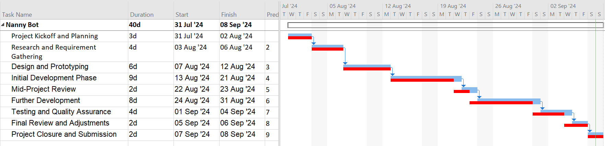
Time Management
: Planned
: Actual

Slide 15
Conclusion
Summary:
The robot enhances daycare safety using 2D SLAM and LiDAR sensors, supporting staff by reducing their workload while ensuring privacy.
Results:
Real-world tests demonstrated a 5.45% error rate in mapping accuracy, with successful autonomous navigation and obstacle avoidance.
Future Vision:
Future enhancements in sensors (3D SLAM), AI for path planning, human-robot interaction (voice/gesture control), and energy efficiency will make the robot a more valuable tool for daycares.

Slide 16
THANK YOU!
ANY QUESTIONS?

